Slide 1
Securing your JavaEE Microservice with HMAC
Presents…
Scott Kramer
Notes:
**STORY** - How and why this presentation came about…
IMPORTANT: Beginner to Advanced....

Slide 2

A little about Presenter…
Currently
STA Architect and “hands on” coder
Our biz is Business Transformation
Also…
Tinker-er
JavaOne Speaker 2014 & 2015
Volunteer(ed) for iJUG, cJUG, Chicago Coder Conference, Police, etc…
Married to woman of my dreams
Certifications: SCJP & wrote several CBT’s, coding 25 years+, and published stuff…
Scott Kramer
Hands-On Architect
STA Group Inc.

Slide 3
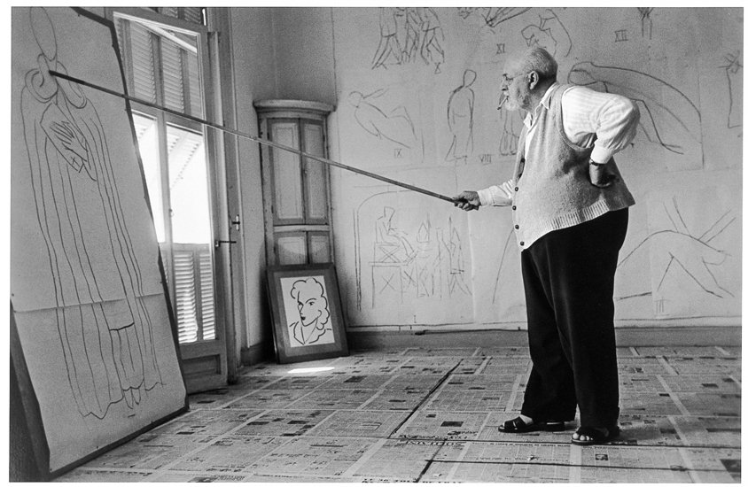
Agenda
Micro-services
Concept and value proposition
Monolithic architecture
Micro-service architecture
Security and data architecture
Securing Micro-services
Cryptology Concepts
HMAC
When, Why, and How to use
Technical implementation
Examples
Source: http://www.phaidon.com/
Notes:
MicroServices: Why Are They Important? What makes them different
Securing: Understand concepts; Different Techniques; Key Management, Distribution, and Issuance

Slide 4
Microservices
.
Notes:
Important to understand a common definition Microservices, how/why differ/evolved; so we can understand the security challenges;
Key Take-a-way is : Microservices are not recommended for all circumstances; but for larger scalable systems they offer significant benefits

Slide 5









Microservices evolution to a family’s evolution…
Payment Processing
Map<Object, Object>
process (Map<Object, Object>)
List<Payment>
processPayments (List<Integer>)
List<StudentPayment>
processStudentLoan (List<Integer>)

Slide 6

Micro-services concepts and value proposition
Service with single business capability
Scalable
Separate process and self-contained
Share nothing model
Independently deployed
Atomic and idempotent
Performant
Usually REST based
Smart endpoint using dumb messaging
Notes:
Encapsulation; Netflix went to AWS starting in 2008; Rearchitected for Microservices from scratch.

Slide 7
Monolithic architecture – High Level
REST API
Encompasses all functionality
Modular architecture
Supports multiple interfaces
All dependencies are well defined and contained
Security
Data Architecture
Underwriting Adapter
Doc Gen.
User Mgmt
Bank Adapter
Quote Purchase
Billing
Payments
Event Notf.
Notification Adapter
DB Adapter
WEB UI
Notes:
Data Arch – canonical models
Security – App level, DB level

Slide 8


Monolithic Architecture - Security & Data
Authentication Server (Storage)
Perimetric Authenticator
Id/pwd Role/Group
Token
App Server
DB Server
UI
Service
DAO
DB
Id/
Password
WAR
Authorization
Authorization
Authorization
DMZ
App Zone
Data Zone

Slide 9
SOA- Security & Data
VM
Perimetric Authenticator
Authentication
Token
VM
VM
WAR
UI
Service
DAO
APP DB
Id/
Password
SOAP
ESB
VM
SAML
LDAP
SSL
WS-Security
VM
VM
VM
VM
SVC A
SVC- A DB
SVC B
SVC - B DB
DMZ
App Zone
Data Zone
Notes:
Monolithic Architecture Evolved; Disintegrated; Use ESB talk to each to other; Realized needed to change for scalability; id/pwd/role

Slide 10
Microservices - Security & Data
VM
Perimetric Authenticator
Authentication
Token
VM
VM
WAR
UI
Service
DAO
APP DB
Id/
Password
REST
REST
VM
VM
VM
VM
SSL
HMAC
SVC A
SVC- A DB
SVC B
SVC - B DB
REST
VM
VM
Partner Service
LDAP
SSL
HMAC
SVC X
SVC - X DB
VM
VM
SVC Y
SVC - Y DB
App/Data Zone
DMZ
Notes:
Security Spread Out; At Service Level; Data Seperated;

Slide 11

Cryptology Concepts
Basic Cryptology Concepts, Techniques, and Algorithms
Notes:
Novice to Expert in a few minutes; Security Concepts; Security Approaches & Techniques; Security Applied

Slide 12
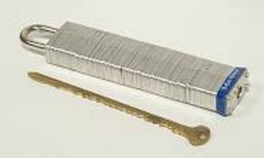

Locks n’ Keys
Locking with a combination number (“key”) is susceptible to someone the guessing answer.
Automated computer guessing is called “brute force”.
Cryptology locking = encryption, unlocking = decryption.
Quick - What is the strongest lock?
Computer locks rely on crazy difficult math problems.
Todays strong lock is tomorrows brute force victim
Longer keys = more processing time to encode/decode
Notes:
-Plain Text and Cipher Text; Strongest Lock? Rumors are quantum cryptography;
-Moore's law (DOUBLING) to catch up: Computers get faster and any encryption, all will be broken at some point in time.
-In 2012, James Bamford published an article saying NSA agency had achieved a “computing breakthrough” that gave them “the ability to crack current public encryption.”
-Snowden documents identified NSA has built extensive infrastructure to intercept and decrypt VPN traffic and suggest can decrypt some HTTPS and SSH connections on demand.

Slide 13




Ongoing Security Challenge…
Message authentication and encryption is simple, fast and stateless.
Easy to change access control based on shared secret keys.
Security is not dependent on the application communication topology.
Sender
Securing Message Transport
Receiver
Sender
Encrypting Message
Receiver
Notes:
-Plain Text vs Cipher Text
-History: earliest history to today problem is always getting message from sender to receiver securely; 2 solutions have emerged.
-Many services use both approaches -> VPN, HTTPS, AMAZON, AZURE, ETC

Slide 14
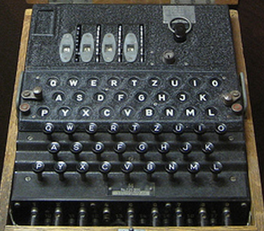
Basic Cryptology Concepts
A B C D E
1 2 3 4 5
ABC = 123
A B C D E
1 2 3 4 5
2 3 4 5 6
3 4 5 6 7
4 5 6 7 8
5 6 7 8 9
ABC = 135
Notes:
-> MATH IS THE BASIS FOR CRYPTOLOGY
-Enigma 159 Trillion Combinations for 4 wheels; 10 wires; or at 1 combo tried a second, 144,000 years!
->Key Concept is that complicated math is difficult even for the fastest computers and thus can be used for cryptology
-Germans sent Heil Hitler and Weather as first words of day

Slide 15

Solution: How two people securely exchange a message ?
Clifford Cox solved this via complex mathematics
RSA, basis for Public key and Private key and more….
Multiplying two numbers is easy, determining the original prime numbers from result is hard.
Factoring large integers that are product of multiplying two large prime numbers is complex.
Can be slow; needs setup (Software Install; Key Locations; Certificate Authority, etc.)
When to use?
Certificate Authority setup;
Configuration not a issue; Protocol independence not required
A
Public Key
Private Key
Alice
Bob
0101010
1011001
0101001
A
Space, The Final Frontier…
Space, The Final Frontier…
Encrypt
Decrypt
Notes:
-James Elis in 1970; -Clifford Cox; Originally classified TOP SECRET
-Bob and Alice – All Security Documents Use it

Slide 16

Solution: 2 People (who never met) create a secret key publicly.
15
Eve
3 mod 17
13
Alice
6
Bob
12
3¹⁵ mod 17 = 6
3¹³ mod 17 = 12
12¹⁵ mod 17 =
6¹³ mod 17 =
10
10
3¹⁵ ¹³ mod 17 = 3¹³ ¹⁵ mod 17
Diffie-Hellman used “Discreet Logarithm” math to solve.
<primitive-root>^{x} mod <base-number> Ξ <result>
One-way encoding is fast even with large numbers
Reversing the encoding without keys is very, very difficult
X * Y
Notes:
Basis for VPN; Email; HTTPS;

Slide 17
Designing a better encryption technique…
Faster than Public/Private; protection from known attacks; simple to implement.
Hashed Method Authentication Code ( RFC-2104 )– basic idea is to concatenate key and message then hash them together.
HMAC = Hash(key ∥ Hash(key ∥ message)).
Unlike SSL it can be transmitted via any protocol with headers, is machine/router independent, and stateless.
Bob
Alice
AB
Shared Key
AB
Shared Key
H&%KS(A…
Space, The Final Frontier…
Space, The Final Frontier…
Space, The Final Frontier…
HMAC
H&%KS(A…
HMAC
H&%KS(A…
Notes:
What makes HMAC more secure than Message Authentication Code (MAC) is that the key and the message are hashed in separate steps.

Slide 18

Cryptology Algorithm Summary…
RSA – Asymmetric algorithm; Public/Private Key. Basis for SSL, SSH, PGP, TLS.
DIFFIE-HELLMAN – Public secure key exchange between 2 parties who have never met.
HMAC – Hashed Message Authentication Code; Very fast symmetric key algorithm
(10 to 100000x).
AES - Advanced Encryption Standard, fast symmetric key algorithm supersedes DES is based on substitution permutation network.
SHA-2 - Secure Hash algorithm, replaced SHA-1(vulnerable) and considered a better choice than MD5. One way computation of hash from message.
Notes:
Any math crypto function relies on a impossible math problem. The longer the key and resulting cipher text determine its strength. As computers get more powerful, crypto is at risk.
The cryptographic strength of the HMAC depends upon the cryptographic strength of the underlying hash function, the size of its hash output, and on the size and quality of the key.
MD5 considered cryptographically broken and unsuitable for further use”
COMBINING TECHNIQUES CAN OVERCOME WEAKNESSES AND ENHANCE SECURITY - Rumors that 128 bit is already compromised.

Slide 19
HMAC: Making it better…
While HMAC is a fast algorithm, the ability to send additional data with the HMAC allows for more benefits (Timestamps, Keys, UserID’s, etc).
When decoding data, quickly discard inauthentic messages
Limits denial of service attacks
It reduces your "attack surface“ (areas where attack can occur.)
Encrypt-then-MAC is provably secure (similar to IPSEC).
Only possible attack against HMACs is brute force to get the secret key....
HMAC-MD5 does not suffer from weaknesses that have been found in MD5.
Notes:
-IPSEC (Tunnel and Gateway Modes)
Stateless! Each request is sent and authenticated independently of what has previously happened.
Thus, it does not require a session or persistent transport connection.
ADD SLIDE????? → When & How to Use HMAC?

Slide 20

Key Problems (pun intended)…
Distribution & Exchange?
Variety of solutions for distribution
LDAP (MD5), Diffie-Hellman, SSL (PGP, AWS, Azure), etc.
.
Management & Authentication?
Design and Implementation Decision
LDAP; OWASP2; SAML; Certificate Authority, etc.
Usage?
Based on design, its an implementation issue.
Factors: Length; Distribution; Replacement; Time Constraints, etc.
Notes:
DEFINE YOUR PROBLEM; SOLVE THE CORRECT PROBLEM
One Time Setup
Design and Implementation Decision (scalability; availability; governance)

Slide 21
Code
Quick Trip Down “Java Crypto Lane” & Some Code Examples

Slide 22

Java Security
Java Security Architecture Overview
Java Authentication and Authorization
JAAS
Java Secure Socket Extension
JSSE
Java Cryptology Extension
JCE
Java Security Architecture
Java Cryptology Architecture
JCA

Slide 23

Java: Important Objects.
KeyGenerator (KeyPairGenerator)– Generates Algo’s Keys
.getInstance() -> .initialize( Algo, Rnd ) -> .generate…()
Key (KeyPair) – Top level interface for all keys
.getPrivate()/.getPrivate() – Gets Key based on Algorithm
Cipher – provides encryption and decryption
.getInstance( algorithm ) – Gets an instance of algorithm’s cipher
.init( mode, key ) – initialize cipher with mode and key info
.doFinal( data ) – encrypt or decrypt data
KeyGenerator
Type, Seed
Key
Public/Private
Algo Objects KeyAgreement
Cipher
Encypt/Decrypt
Notes:
-Java ships with inferior 128 bit encryption with InvalidKeyException for export protection! Download Java Cryptology Extension JAR’s for maximum encryption.
-Slight differences in objects but basic elements the same

Slide 24
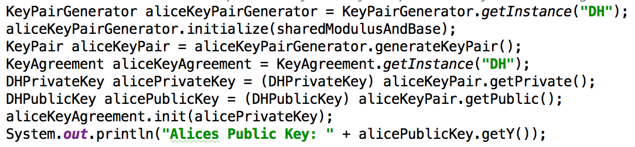

DH Code: Shared Key Calculation
Mutual
Key Generator
Random Key
Key Pairs
DH Type
Result of Prime/Modulus using Alices Private Key
Using Bob’s Init result of Secret/Prime/Modulus yields shared key.
Using Bob’s Init result of Secret/Prime/Modulus yields shared key.
Using Bob’s Init result of Secret/Prime/Modulus yields shared key.
Using Bob’s Init result of Secret/Prime/Modulus yields shared key.
24
Notes:
-Java ships with inferior 128 bit encryption with InvalidKeyException for export protection! Download Java Cryptology Extension JAR’s for maximum encryption.
-Slight differences in objects but basic elements the same

Slide 25
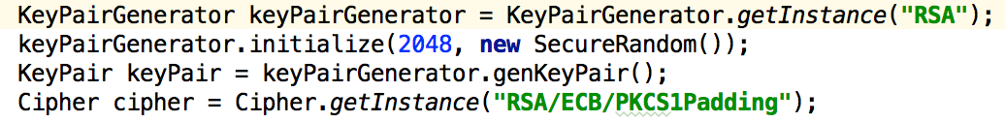
RSA Code: Public Private Key
RSA Keypair
Key Length
Random Seed
Cipher Setup
Cipher Setup
Data
Cipher Setup
Data
Decryption
25

Slide 26
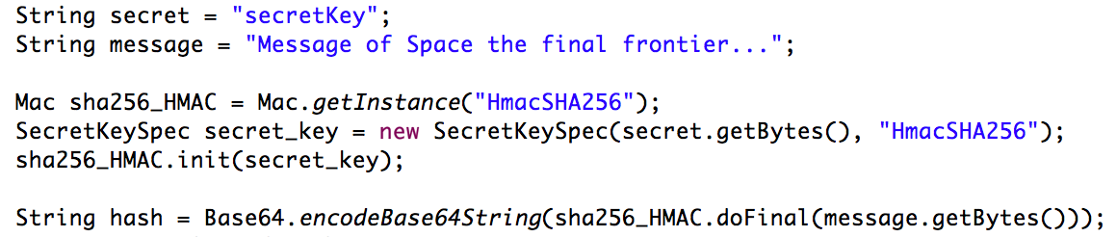
HMAC Code: Creating a Hash
The sender generates a HMAC code that is sent with the message, the receiver calculates the HMAC for the message to authenticate it against senders HMAC.
Create HMAC Object
Initialize HMAC with that key
Create a Key
Create HMAC Code

Slide 27
Sample HMAC Implementation
Product Service
WAR
UI
Interceptor
HMAC Creation
HMAC Creation
REST
REST Controller
Client JAR
WAR

Slide 28
HMAC Code
Client
Client
Request
AccessKeyId = …
Timestamp = …
1
Create a request:
Create
HMAC-SHA
signature:
String based on request contents
2
HMAC
CALC
Your Signature
Secret Access Key
wJalrXUtnFEMI/K7MDENG/
bPxRfiCYzEXAMPLEKEY
3
Send request and signature to Service:
Request
AccessKeyId = …
Timestamp = …
Service
Your Signature
Notes:
The sender generates a HMAC code that is sent with the message, the receiver calculates the HMAC for the message to authenticate it against senders HMAC.

Slide 29
HMAC Code
Service
Service
Request
AccessKeyId = …
Timestamp = …
Secret Access Key
Get Access Key ID
4
Retrieve Secret Access Key:
wJalrXUtnFEMI/K7MDENG/
bPxRfiCYzEXAMPLEKEY
Your Signature
Get Secret Key
Create HMAC-SHA signature:
String based on request
5
HMAC
CALC
Calc Signature
Secret Access Key
wJalrXUtnFEMI/K7MDENG/
bPxRfiCYzEXAMPLEKEY
Yes:
->Request authenticated
No:
->Request fails authentication
Compare the two signatures:
Calc Signature
Request Signature
6
?
Client

Slide 30
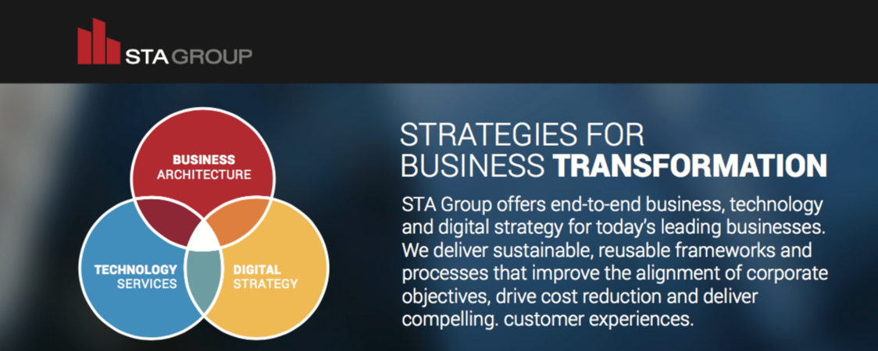
Mobile – Develop wide range of mobile apps for Fortune 500
Cloud – Expert cloud knowledge in host of technologies
Big Data – Certified in implementing many Big Data technologies
Security – Specialists in Application and Service Security
Digital Strategy – Handles many companies digital brands and UX
I.O.T .Technology – Significant IOT Developer for Fortune 500

